Slide 1
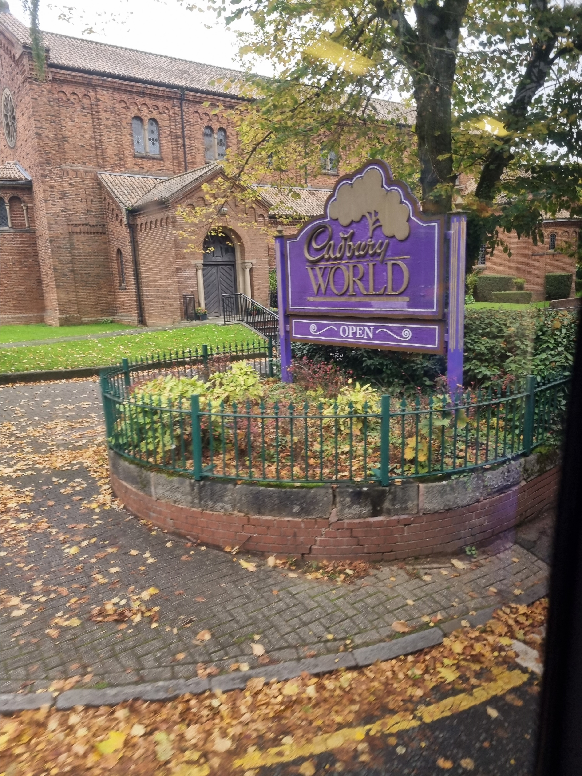
Welcome
New Year 5’s

Slide 2
WHAT EQUIPMENT YOUR CHILD WILL NEED
It is important that your child is prepared for their everyday learning. This is what they will need:
Pencils
Handwriting pens (blue – not Biros)
Rubber/pencil sharpener
30cm ruler not bendy
Glue
Colouring pencils
Whiteboard pen
Green pen
Reading book/Record
Scissors
Highlighters

Slide 3
HOMEWORK
Homework is set every week on a Tuesday and is due in on the following Monday.
Homework activities are listed on Google classroom. (Your child will be set up and an invitation sent to them).
The children will get Maths, English and Spellings every week.
They will also be expected to read every night for 20 minutes.

Slide 4

CLUBS
Huge variety of lunchtime and afterschool clubs.
All clubs will commence within the first two weeks once the timetable has been put together.
PBA Extra will commence from Wednesday 3rd September. If you require a registration form, please contact the school office.

Slide 5
REWARDS
From September, we will be using a new system called Bromcom to record merits for the children.
There will be a variety of new awards which will be rolled out in September. These include praise postcards, jump the lunch queue and many more…
Children are regularly rewarded with praise and also stickers/stampers in their books.
Each class has a ‘Wow’ work board where pieces of work are chosen to be displayed.

Slide 6
THE FIRST DAY:
Wednesday 3rd September
Pencil case and equipment
Water bottle
Reading book
Packed lunch
Summer Homework
Something to keep them all in!
All items should be named where possible

Slide 7
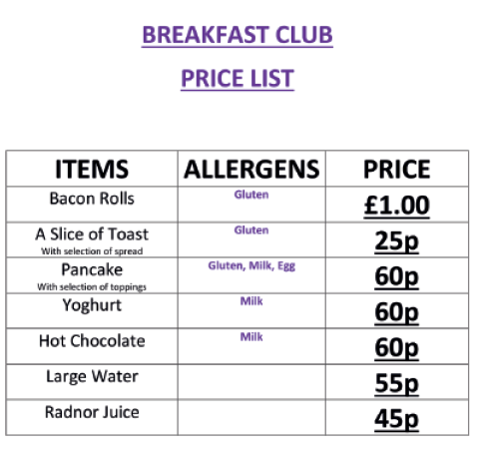
TIMINGS OF THE DAY
Children can arrive from 7:30am (breakfast available)
All pupils must be in school by 8:15am
8:20 – 8:40 Tutor Time/Assembly
8:40 – 10:20 Lessons
10:20 – 10:40 Break
10:40 – 12:20 Lessons
12:20 – 1:10 Lunch
1:10 – 2:55 Lessons
2:55 – 3:00 Registration
3:00 Home time

Slide 8
LUNCH
For the first week, please can all children bring a packed lunch.
During this first week, all pupils will be set up on our cashless catering system. This is a Biometric System which recognises the thumb of your child at the tills. Children will make their own meal choice on the day and pay for it via their thumb. The menu will be advertised in advance on our website and also in the PBA Weekly Bulletin sent out via ParentMail.

Slide 9
LUNCH
Any amount of money can be prepaid and topped-up on a pupil’s account via the ‘Accounts’ section on your ParentMail account, and any money spent on food will be deducted on a daily basis. A daily ‘spend limit’ of £5 will be programmed into the system.
If you choose not to have your child registered on the Biometric System, a PIN code will be allocated. Please note that PIN codes do not have the same level of security and it will be your child’s responsibility to remember the code and keep it secure at all times.

Slide 10
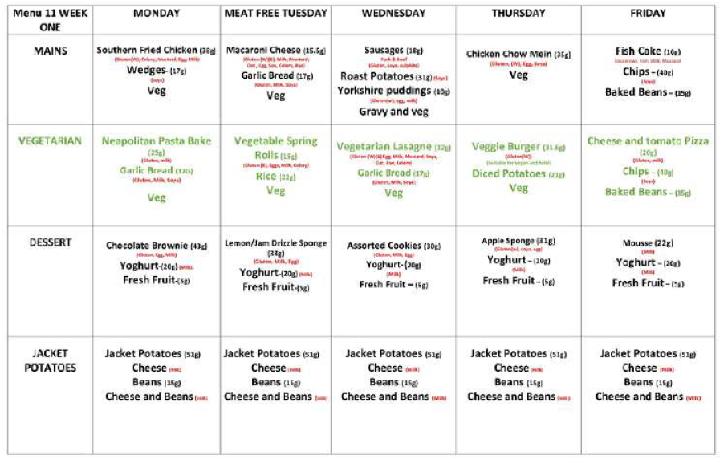
EXAMPLE LUNCH MENU

Slide 11
CONTACTING THE SCHOOL
Teacher: initialsurname@bestacademies.org.uk
Mr Cresswell (Head of Year 5): ocresswell@bestcademies.org.uk
Mrs Smyth (Director of KS2): tsmyth@bestacademies.org.uk
Office: pixbrook@bestacademies.org.uk
School phone number: 01462 416243

Slide 12
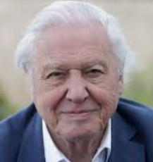
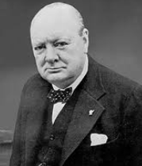
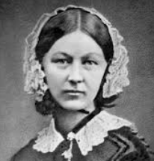
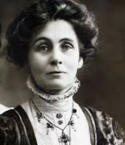
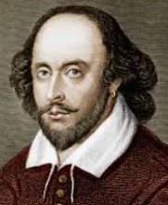
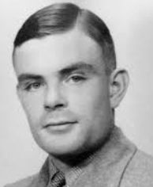
SUMMER HOLIDAY HOMEWORK!
We have set a challenge called ‘Identity’ for you to complete over the Summer holidays. This will be research based and link to your class name.

Slide 13
SEE YOU ON FRIDAY!
If your child will require any medication, please bring it in to Reception and hand it to our Medical Officer where you will need to complete a Medication Form providing us with permission to administer.
Any questions?

