Slide 1
Welcome
New Year 5s

Slide 2
Mrs Linehan
Principal

Slide 3
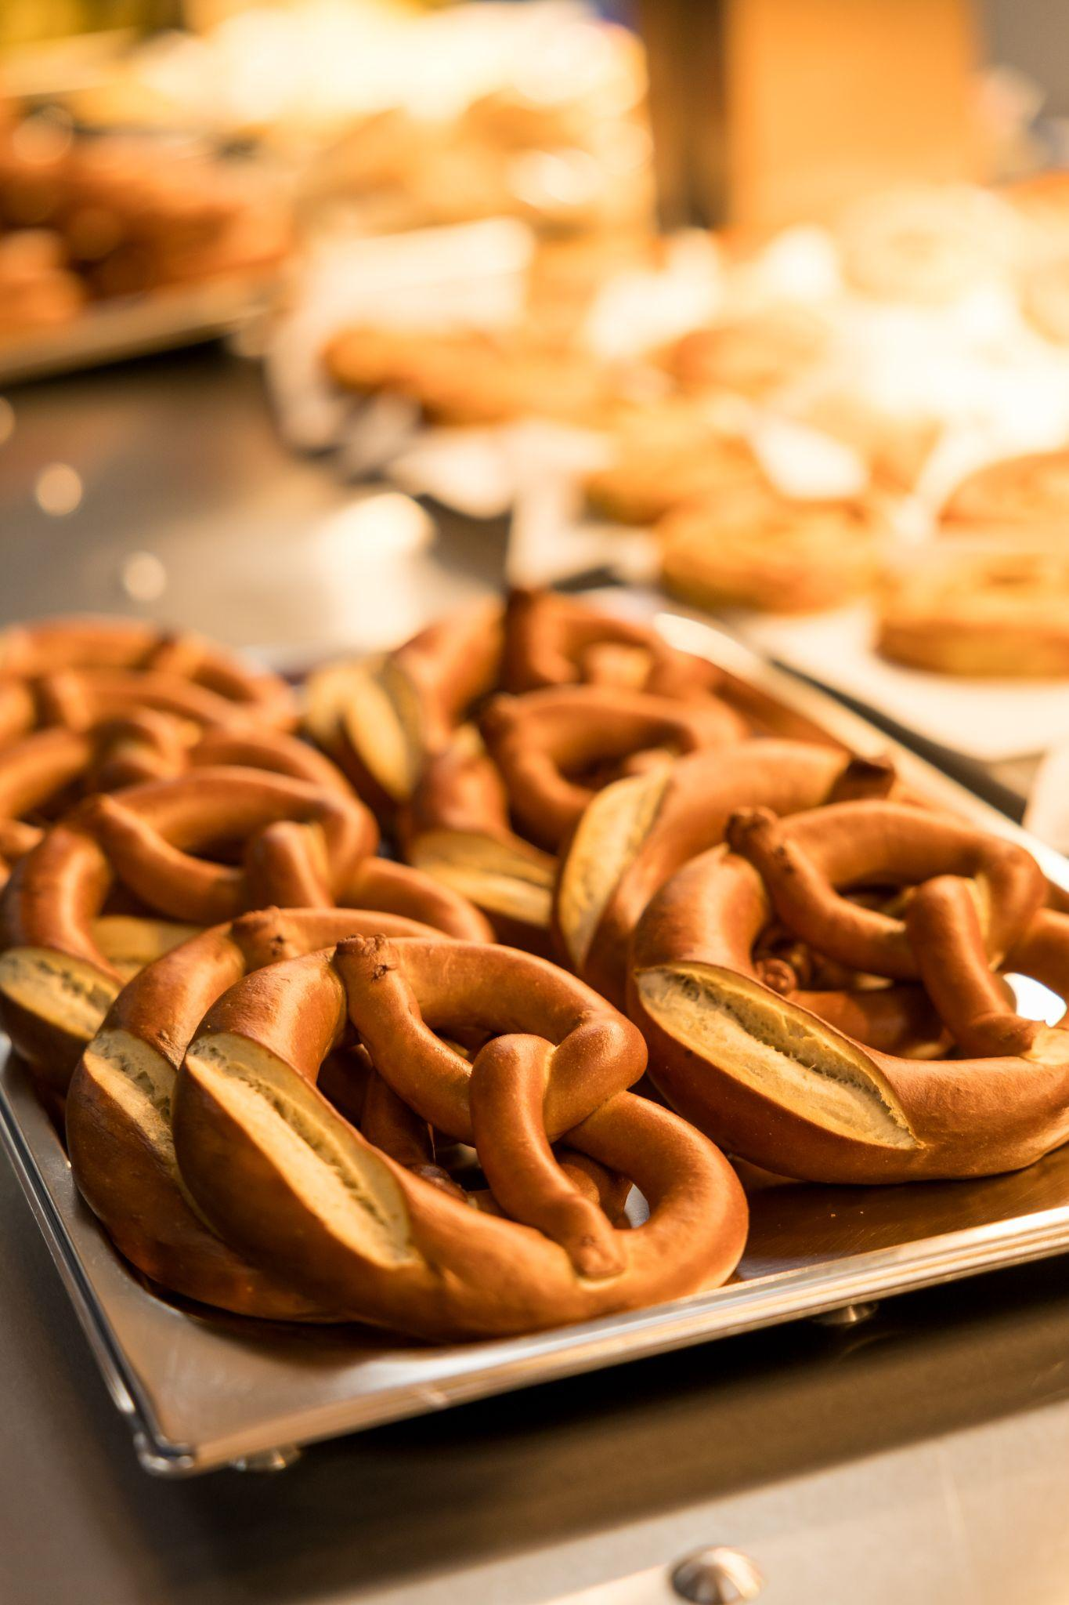
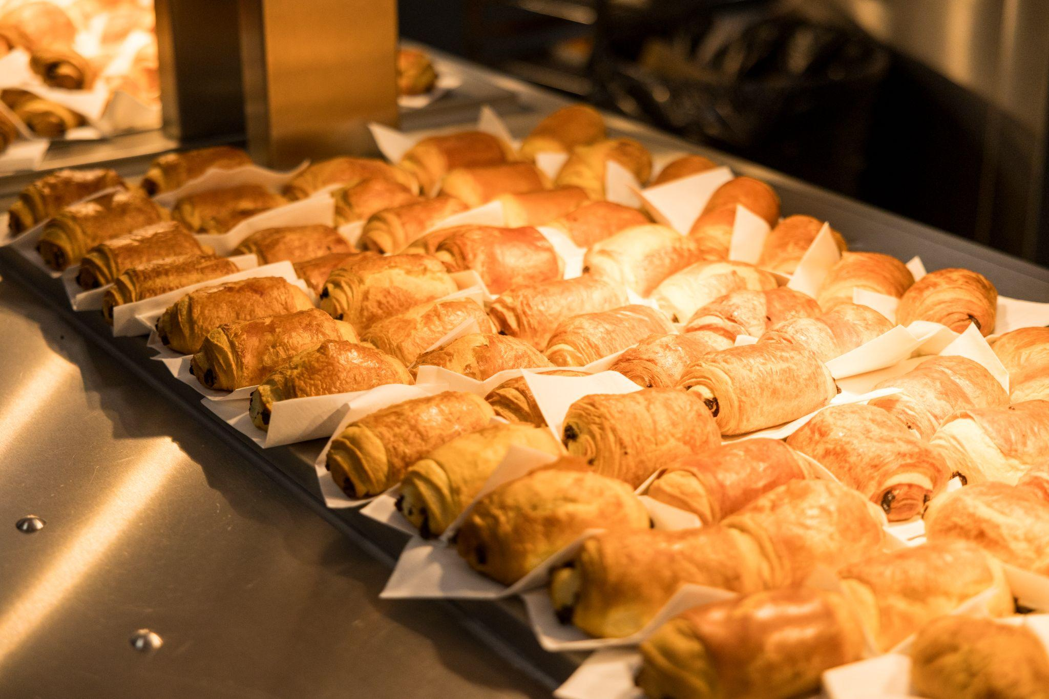

Slide 4
Mission, Vision and Values
Pix Brook Academy (PBA) has a mission to educate the socially responsible citizens of the future by being relentlessly aspirational in all aspects of school life. This mission, together with our five core Pix Brook values: Positive, Prepared, Polite, Proud, Perseverant, underpin both the intent and actions of the school.
These values, alongside the PBA tagline: Owning Our Actions, Shaping Our Future permeate the policy and practice within the school, and have at their heart the clear moral purpose in ensuring that all members of Pix Brook Academy continually focus on improving and enhancing their life chances, reminding students that their behaviour and learning choices are key to their future successes.
Ultimately, the goal of the school is for young people to leave prepared for their future. They will be conscious of their responsibilities to others and leave with the skills, both academic and personally, necessary to achieve their goals in society.

Slide 5
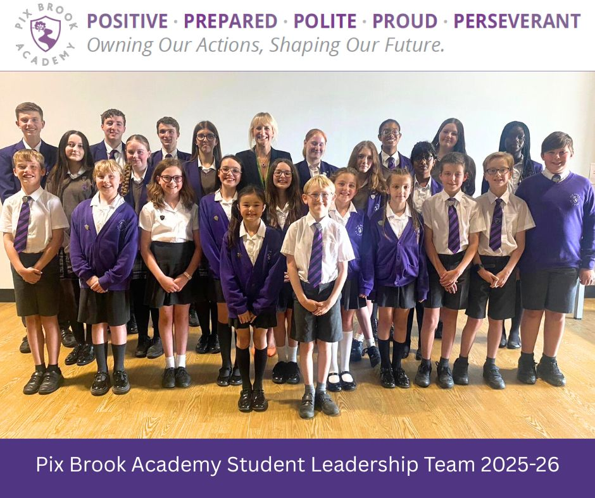
Mrs C Linehan, Principal
Educating socially responsible citizens.
Traditional values in a modern context.
Developing student leadership and life skills.
Forging links with the community.

Slide 6
Positive
Proud
Prepared
Polite
Perseverant

Slide 7
WHAT TO EXPECT IN YEAR 5
Mrs Tracy Smyth
Assistant Principal/ Director of KS2

Slide 8
YEAR 5 FORM NAMES / TUTORS
Attenborough: Miss Parsons
Churchill: Mr Lindley
Nightingale: Miss Montgomery
Pankhurst: Miss Boyle
Shakespeare: Mr Prue
Turing: Mr Cresswell (Head of Year 5)
All the Year 5 forms are named after inspirational people!

Slide 9
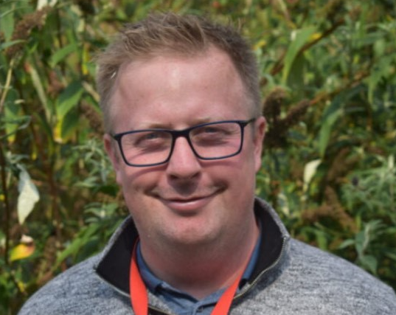
A MESSAGE FROM MR CRESSWELL
I am very excited about joining Pix Brook as their philosophies align with my own as I ambitiously strive for the best for all the children I work with.
I believe in creating a happy, open and honest line of communication to support your children during their first year at Pix Brook.
I have a passion for sports and had the opportunity the play rugby in Australia for two years before choosing the teaching profession.

Slide 10
TEACHING THE PRIMARY WAY
We follow a Primary Based Curriculum meaning most of the lessons will be taught by your child’s form tutor.
Each term all of our core subjects will be linked to a specific theme.
Autumn Term: Marvellous Mayans!
Spring Term: Ultimate Survivor!
Summer Term: All the World’s a Stage!

Slide 11
EXPECTATIONS
Owing Our Actions, Shaping Our Future
Our aim is to educate the socially responsible citizens of the future.
Positive: All students give 100% in all lessons
Prepared: All students arrive with their equipment
Polite: All students show respect to peers and staff
Proud: All students wear the correct uniform
Perseverant: All students learn from their mistakes

Slide 12
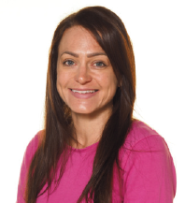
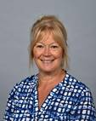
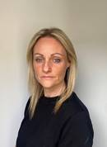
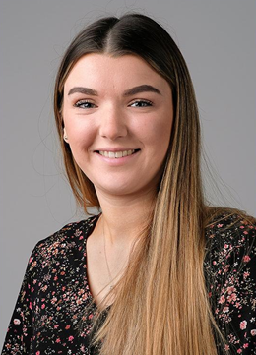
PUPIL SUPPORT
Director of KS2: Mrs Smyth
Head of Year 5: Mr Cresswell
SENDCo: Mrs Hepworth
Assistant SENDCo: Miss Gifford
SEN Teachers: Miss Vaughan/
Mrs Laurie

Slide 13
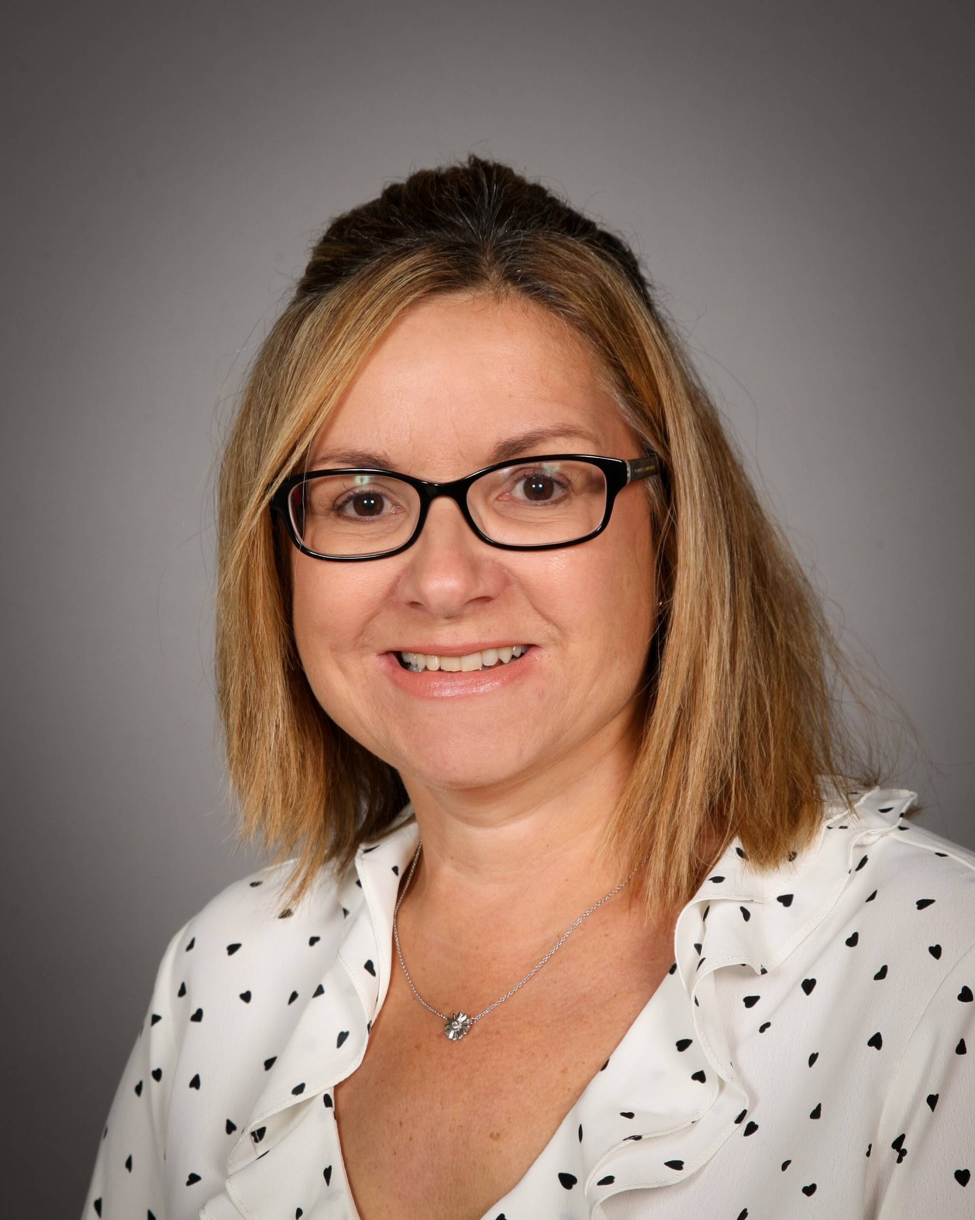
SAFEGUARDING TEAM
We have a dedicated safeguarding team led by our DSL (Designated Safeguarding Lead) Mrs Theobald.
This team includes all Heads of Year alongside Mrs Hepworth and Miss Vaughan.

Slide 14
A TYPICAL YEAR AT PIX BROOK
Parents Evenings
Open Evening
Trips: Cadbury’s World/ Pantomime/Young Voices etc
Celebration Assemblies
Visitors: Pop up planetarium
Sports Day
Plus many more added throughout the year.

Slide 15
It will be a busy and exciting year for you and your children…
BUT ABOVE ALL… RELAX!
Pix Brook pupils are happy and confident pupils! Amazing things happen here as…
WE ARE ALL TEAM PIX BROOK!

